Slide 1

Event-Based Asynchronous
Processing System
Rahul Singh Thakur
s1776200
MSc Electronics
The University of Edinburgh
Project supervisor : Dr Alister Hamilton
Thesis examiner : Dr Stewart Smith

Slide 2
Objective
The project aims to design a low resolution asynchronous processor using an event-driven data acquisition to reduce the power dissipation of the system.
2

Slide 3
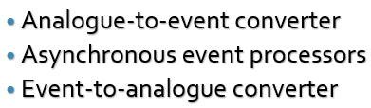
Introduction
Power is one of the prime concerns for the designers in designing devices.
This project describes event-driven scheme with a digital signal processor that offers a significant reduction in the power conservation.
The project is divided into three main parts-
3
Notes:
Solution to the problem of power dissipation is event based data acquisition or clockless approach

Slide 4
Block diagram of the system
Analogue-to-event converter (AEC)
Processor
Event-to-analogue converter (EAC)
Figure 1 :Block diagram of the system
4

Slide 5
Analogue-to-event converter
The aim of this section is to convert analogue signals to events which can be later processed by an event processor.
5

Slide 6
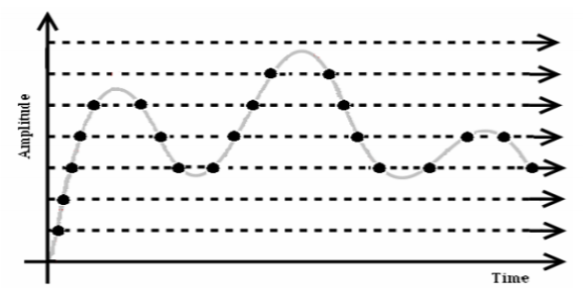
Analogue-to-digital converter
Done using two approaches –
Synchronously
Asynchronously
Figure 2 :Level crossing sampling [1]
6

Slide 7
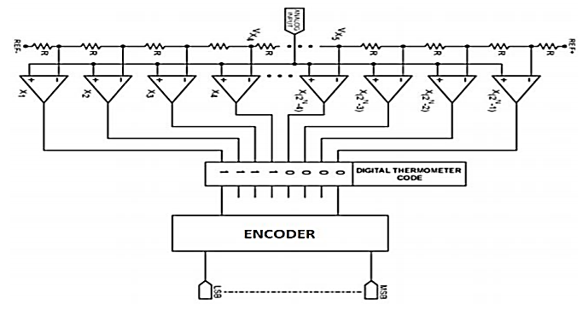
ADC using flash converter
Level crossing sampling scheme
discussed is implemented using a
high speed flash converter.
A comparator is used to convert
digital signals to events.
Figure 3 :Flash converter[2]
7

Slide 8
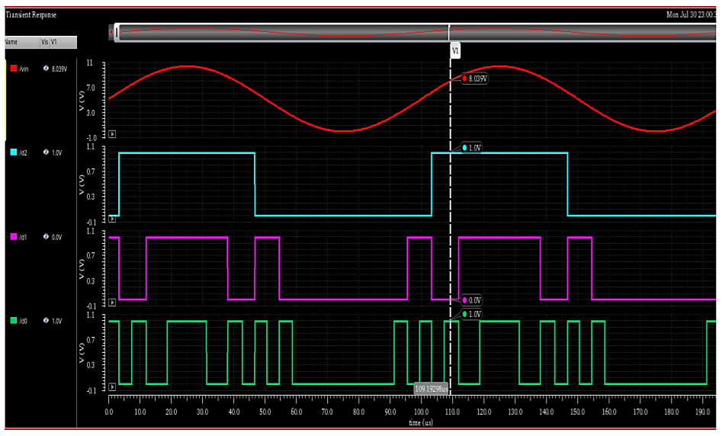
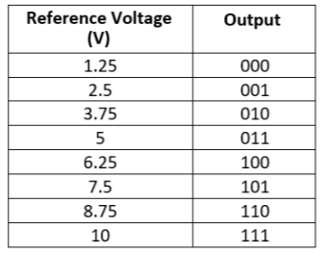
Simulation result of ADC
Implemented a comparator block in Verilog-A.
Implemented a flash converter in Verilog-A.
Table1: Output of 8X3 Flash ADC in terms
Of reference voltage
In figure 4-
Red – analogue input wave of 8V,
Light blue – d2, logic ‘1’
Magenta – d1, logic ‘0’
Green – d0, logic ‘1’
Figure 4 :Simulation of flash ADC with encoder
8

Slide 9
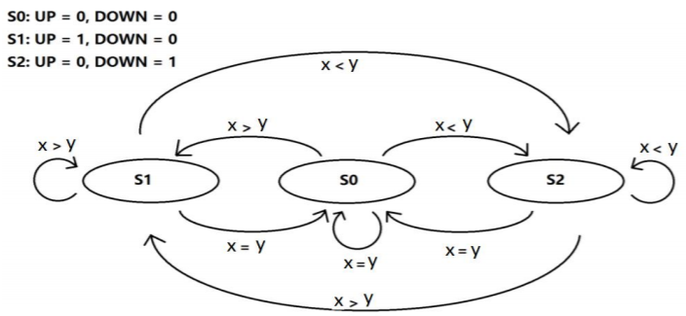
Event generator
Event – A sample or a spike which is generated when something significant occurs[1].
Figure 5 : A finite state machine to generate events[2]
9

Slide 10
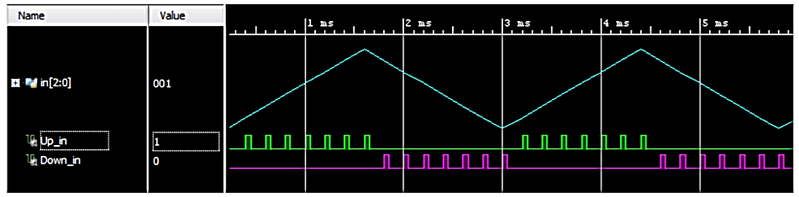
Simulation result of event generator
Former value is compared to the current value and UP,DOWN events are generated.
Figure 6 : FPGA simulations of event generator
10

Slide 11
Asynchronous event processor
The aim of this section is to process the events using an FIR low pass filter designed on field programmable gate array(FPGA).
11

Slide 12
Advantages and disadvantages of using asynchronous processors
Advantages
Disadvantages
Higher performance
Power efficiency
Speed of the circuitry
Smaller chip size (sometimes)
Complex design
Tough to troubleshoot
Lack of development tools
Larger area (sometimes)
12
Notes:
Performance – no local delay, no clock , processing done at environmental rate
Power - No clock no power wastage, No glitches, Only active components takes the power

Slide 13
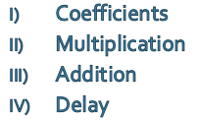
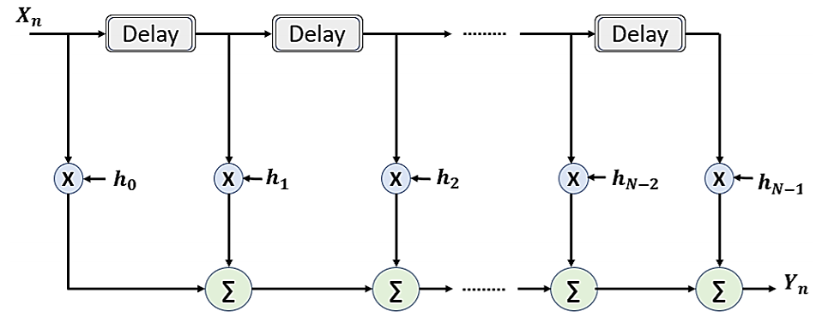
Asynchronous processor
Asynchronous processor is implemented on FPGA using Verilog HDL.
To design a LPF following parts are required-
Figure 7 : A low pass finite impulse filter[3]
13

Slide 14
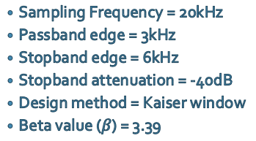
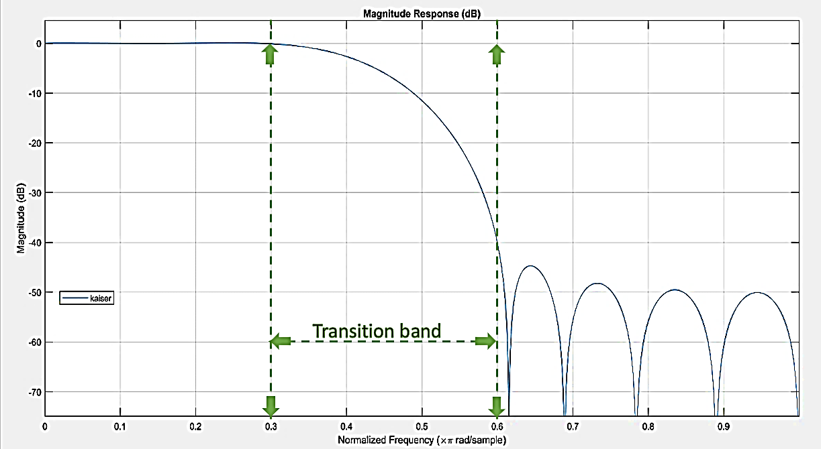
Filter design on MATLAB
Kaiser low-pass filter is implemented on MATLAB with the following specifications-
Figure 8 : Kaiser low-pass filter
14

Slide 15
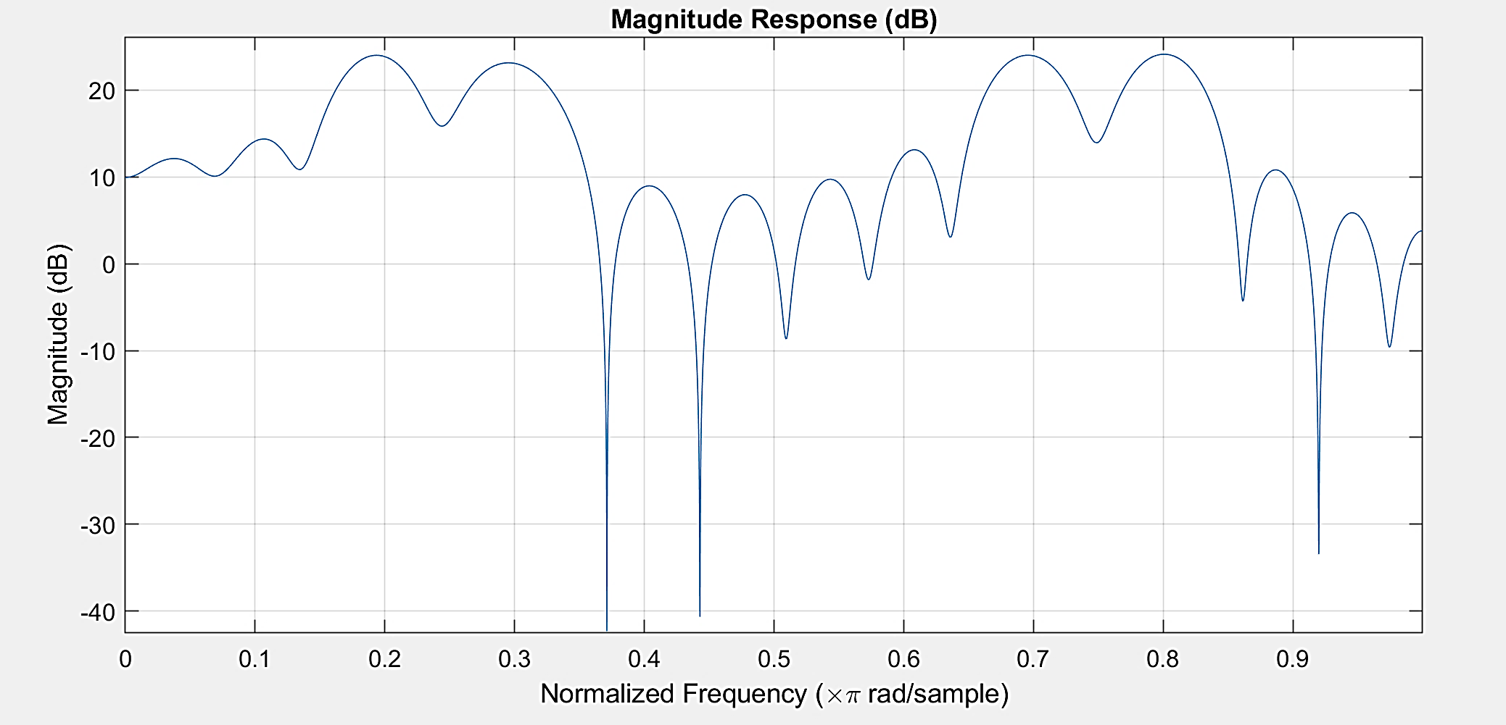
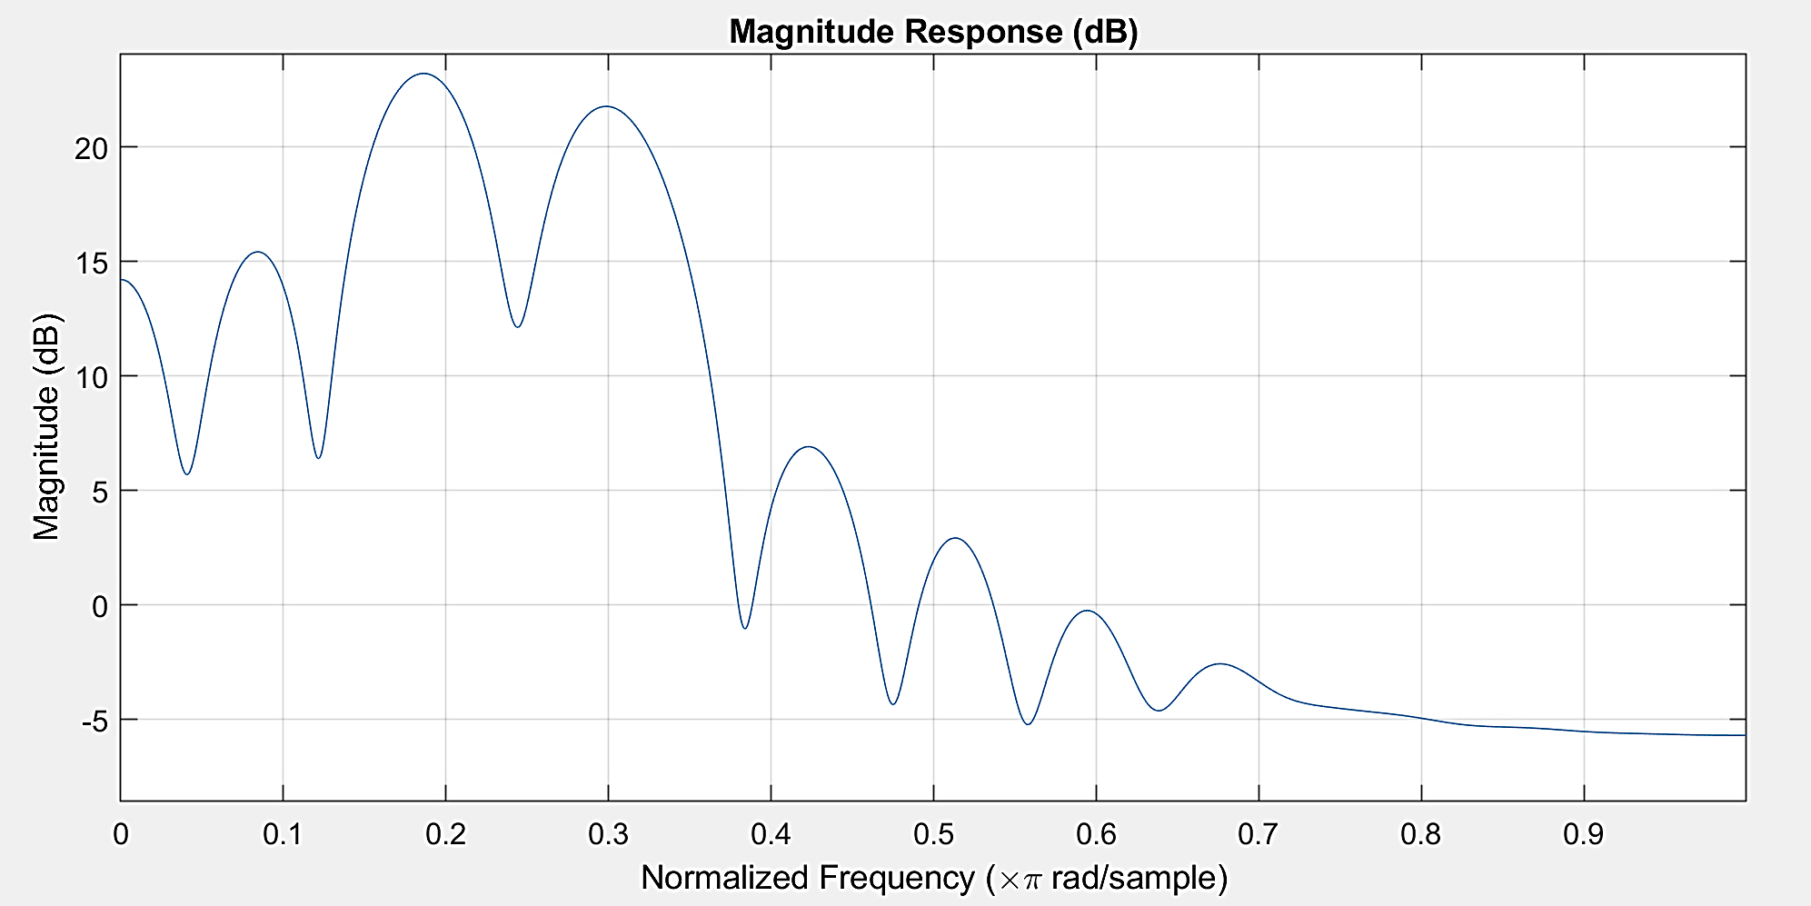
Simulation result of LPF with different inputs
a)
b)
Figure 9: a) Four different input of 2kHz, 3kHz, 7kHz and 8kHz sinusoidal waves were given to the Kaiser LPF.
b) Output after the mixed signal passes LPF.
LPF is successfully designed in MATLAB.
15

Slide 16
Filter design on FPGA
Coefficients are generated through MATLAB are scaled and converted to integer values.
These coefficients are then multiplied with the input and delayed input signal generated through delay blocks.
The multiplication results are then added by an adder in FPGA to generate the output.
Delays are generated through analogue delay lines.
16

Slide 17
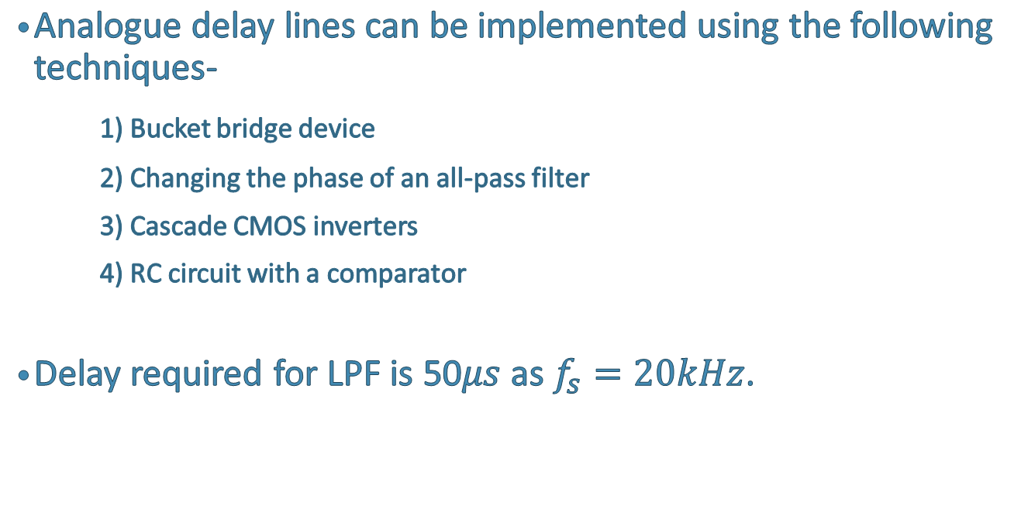
Delays
Analogue delay lines can be implemented using the following techniques-
1) Bucket bridge device
2) Changing the phase of an all-pass filter
3) Cascade CMOS inverters
4) RC circuit with a comparator
Delay required for LPF is 50$μs$ as $f_{s}=20kHz$.
17

Slide 18
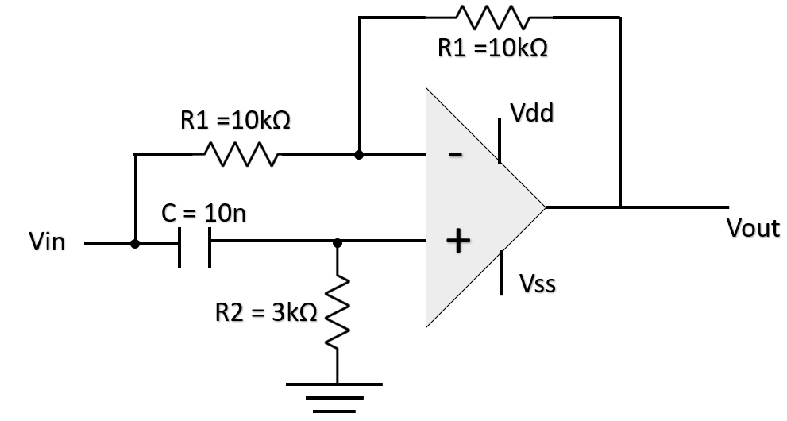
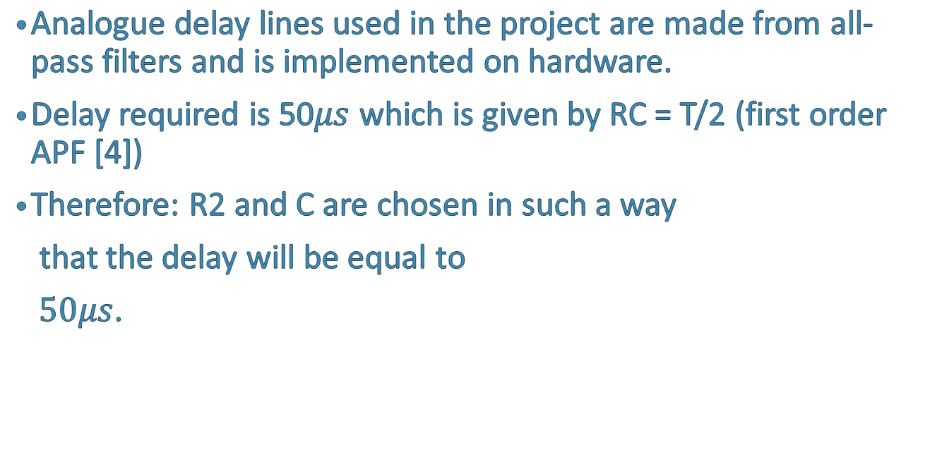
Delay using all-pass filter
Analogue delay lines used in the project are made from all- pass filters and is implemented on hardware.
Delay required is 50$μs$ which is given by RC = T/2 (first order APF [4])
Therefore: R2 and C are chosen in such a way
that the delay will be equal to
$50μs$.
Figure 10 : APF first order[4]
18
Notes:
APF are used to implement delay because of its circuitry (small and precise results)
Resistive feedback is a voltage divider
Made on hardware

Slide 19
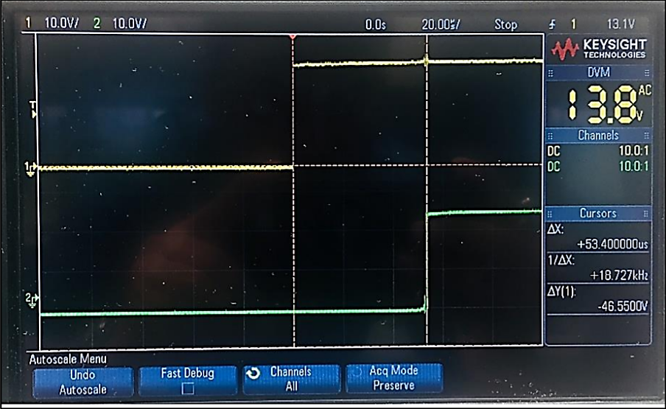
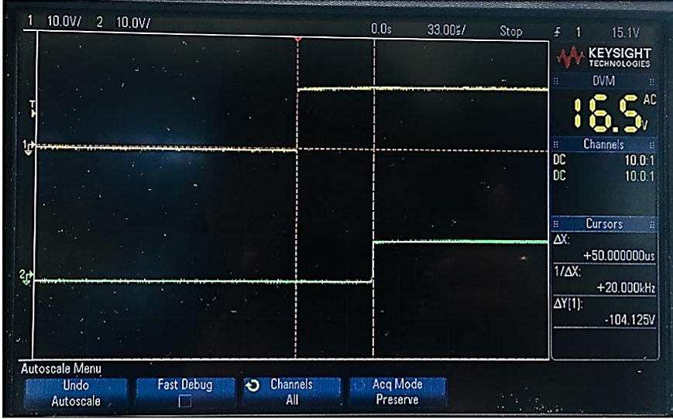
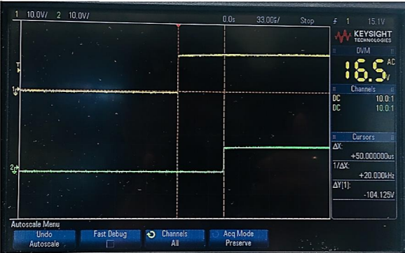
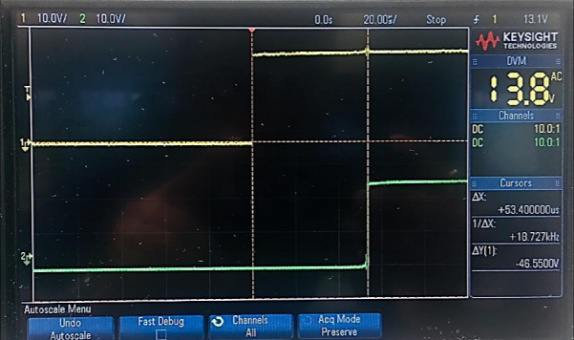
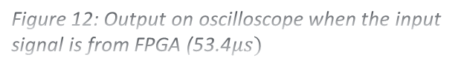
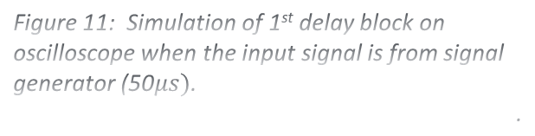
Simulation result of delay line
Figure 11: Simulation of 1st delay block on
oscilloscope when the input signal is from signal
generator (50$μs)$.
.
Figure 12: Output on oscilloscope when the input
signal is from FPGA (53.4$μs)$
Analogue delay blocks are successfully implemented on hardware.
19

Slide 20
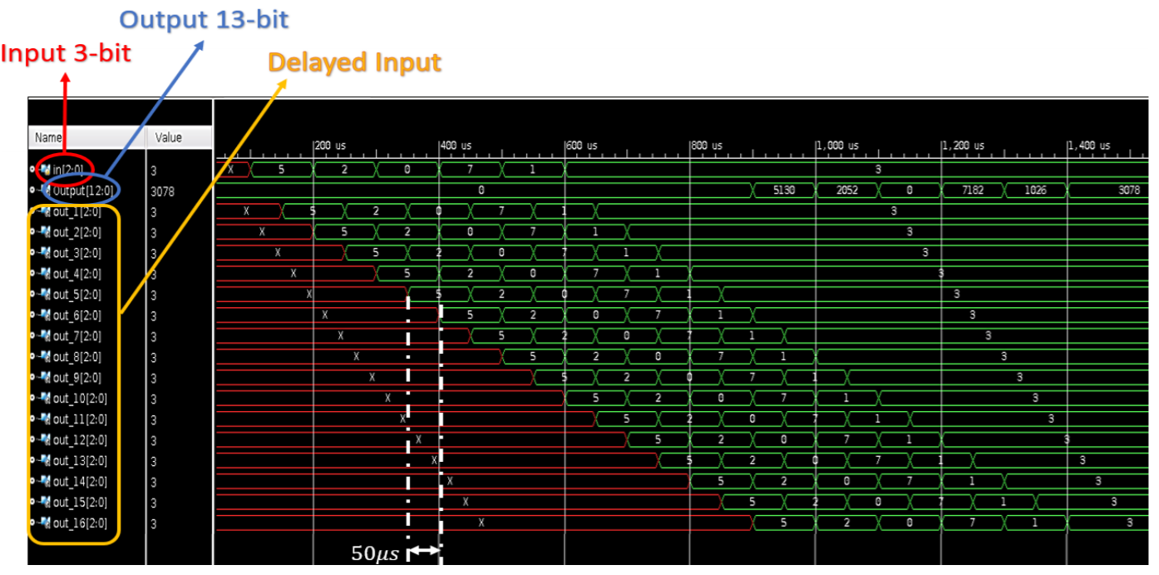
Simulation results of LPF on FPGA
Figure 13: Simulation result of FPGA with analogue delay line.
20

Slide 21
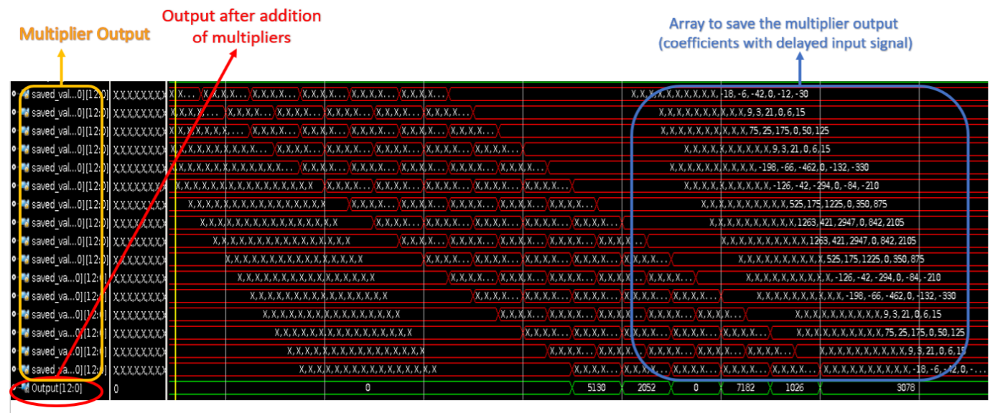
Simulation results of LPF on FPGA
Figure 14: Simulation result of adder and multipliers.
21

Slide 22
Event to analogue converter
The aim of this section is to convert events to analogue signals processed by an event processor.
22

Slide 23
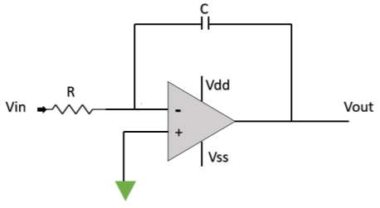
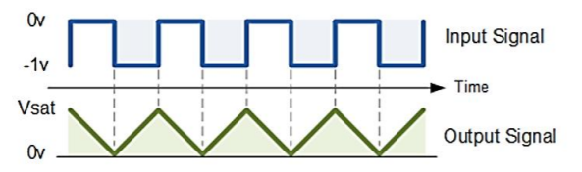
Digital-to-analogue converter
There are many ways to convert digital signals to analogue signals one such way is using op-amp as an integrator.
Figure 14 is implemented on hardware to convert digital signal to analogue signal.
Figure 15: Op-amp as an integrator[5]
Figure 16: Input and output of an integrator[5]
23
Notes:
R2R ladder
Summing amplifier DAC
Thermometer code Dac
And opamp as integrator

Slide 24
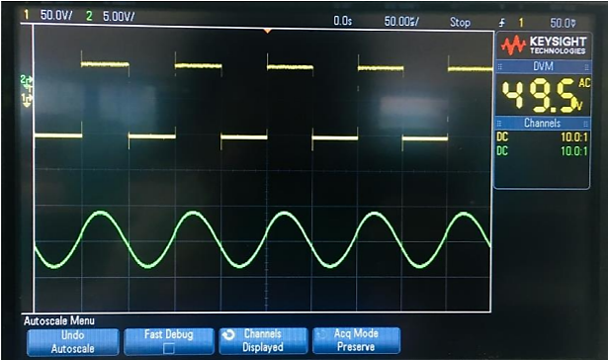
Simulation results of DAC
Figure 17: Simulation output of a DAC
24

Slide 25
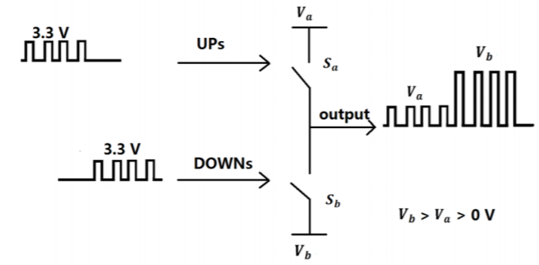
Event-to-analogue converter
Event-to-analogue converter is a process to convert events back to analogue signal.
The output from FPGA is a 3.3V (UP and DOWN).
New delta-mod representation is required to distinguish between UP, DOWN signals.
Figure 18: New delta-mod representation of UP, DOWN signal[2]
25

Slide 26
System level integration
The aim of this section is to integrate all the modules and test the working of the system.
26

Slide 27
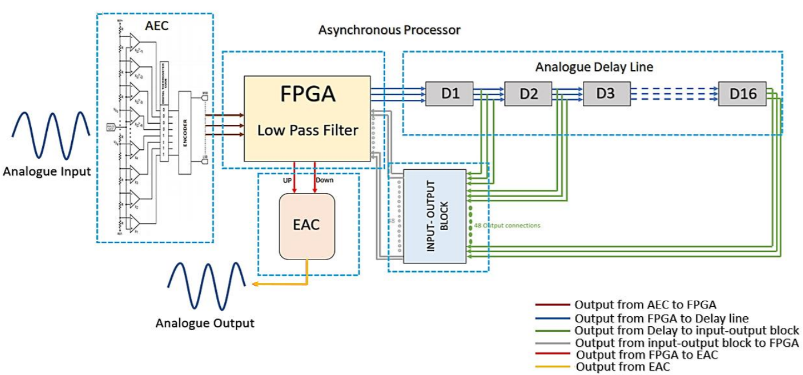
Block diagram of the entire system
Figure 19: Block diagram of the entire system.
27

Slide 28
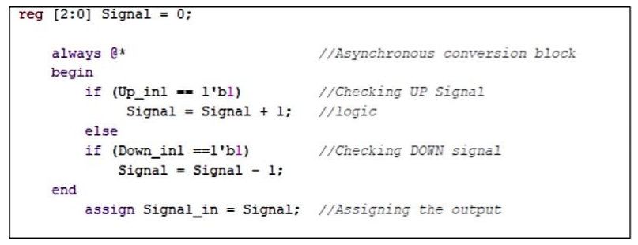
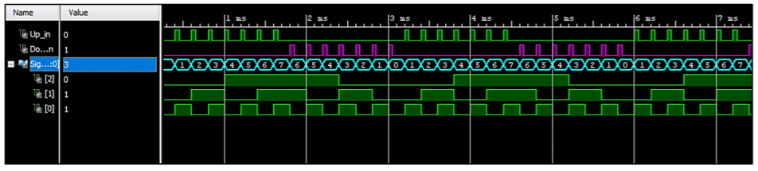
Digitisation event-to-digital conversion
a)
b)
Figure 20: a) Code snippet for event to digital conversion.
b) Simulation result of the above code snippet.
28

Slide 29
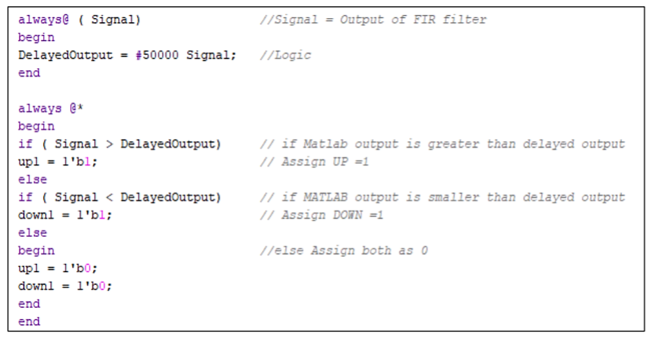
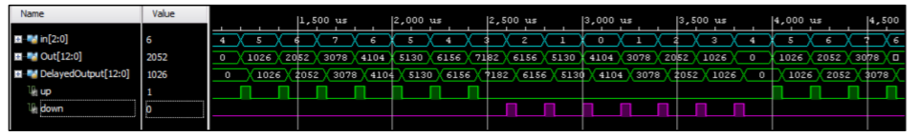
Digitisation digital-to-event conversion
a)
b)
Figure 21: a) Code snippet for digital to event conversion.
b) Simulation result of the above code snippet.
29

Slide 30
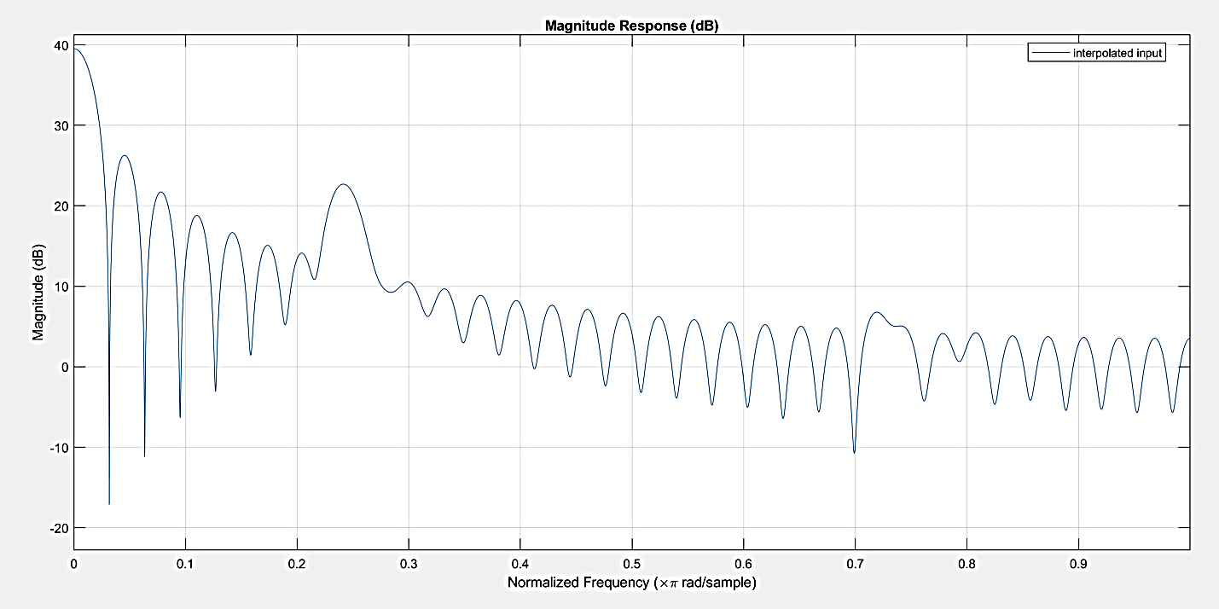
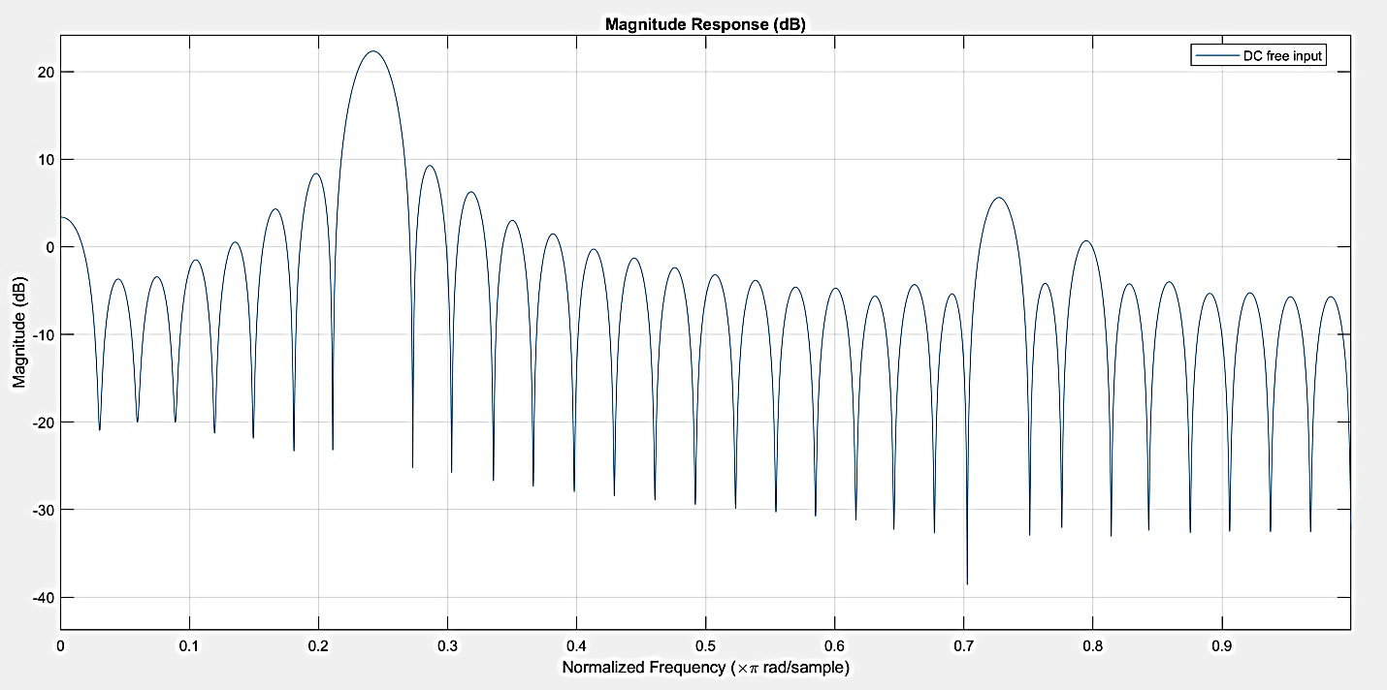
Verification of FPGA output on MATLAB
a)
b)
Figure 22: Input given to FPGA is 2.5kHz wave. a) Output from FPGA with DC values.
b) DC free output of figure 22.a..
30

Slide 31
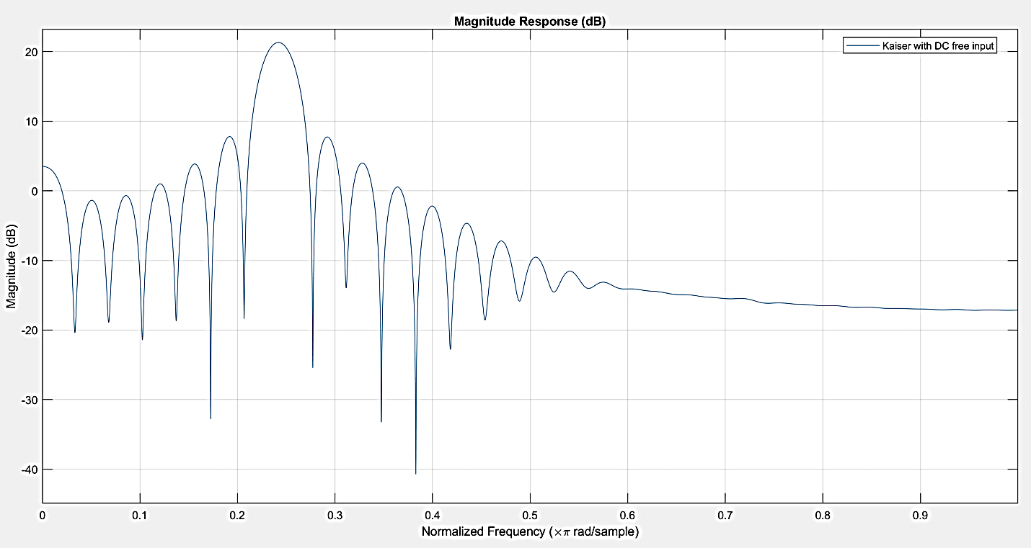
Verification of FPGA output on MATLAB
Figure 23: Magnitude response of the FIR filter of figure 22.
31

Slide 32
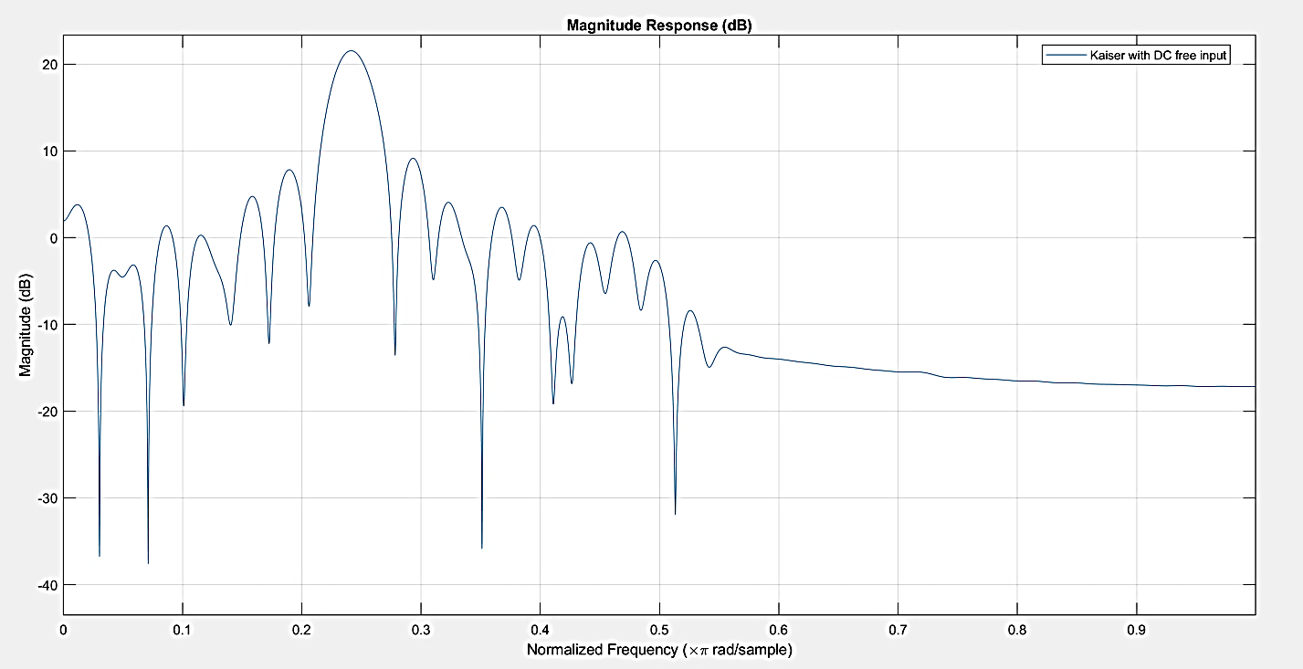
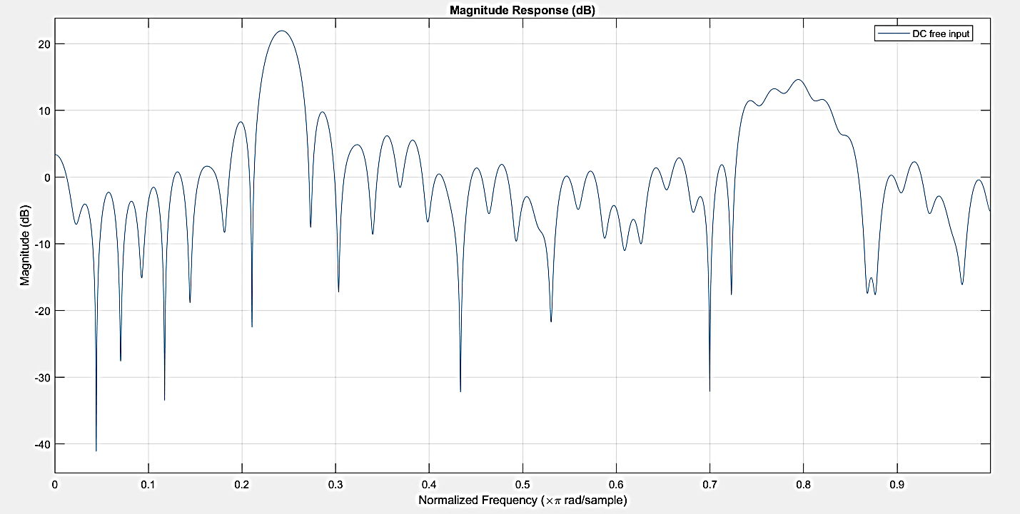
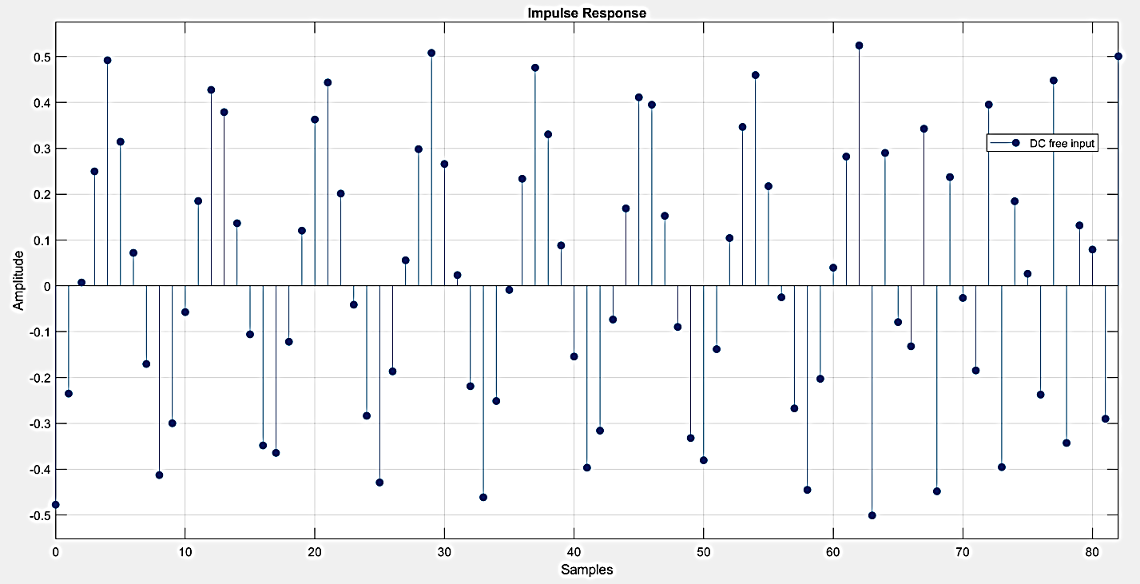
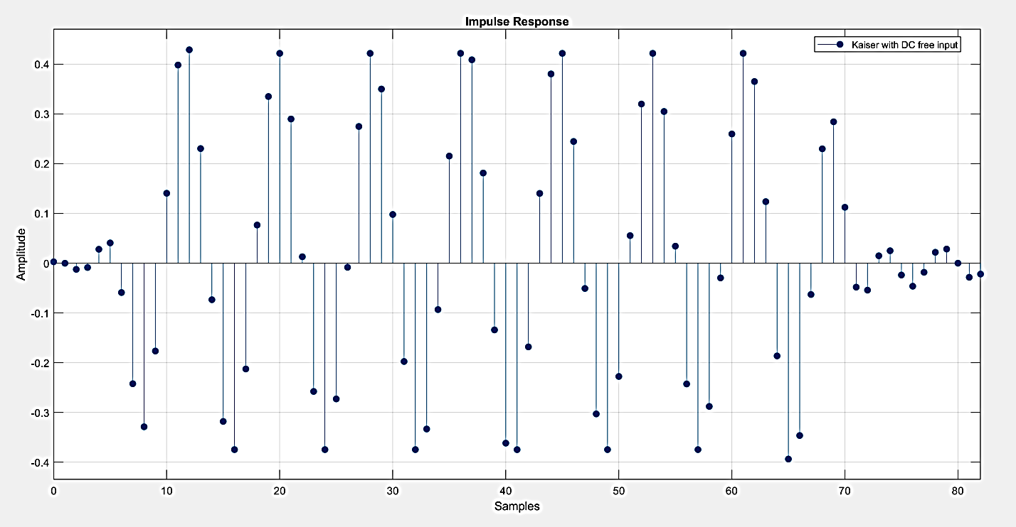
Verification of FPGA output on MATLAB
a)
b)
c)
d)
Figure 24: Input given to FPGA is 2.5kHz and 7.5kHz wave. a) and b) are magnitude response of input and output of filter
c) And d) are impulse response of the above figures..
32

Slide 33
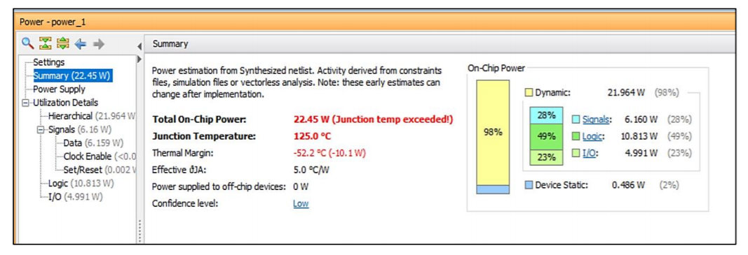
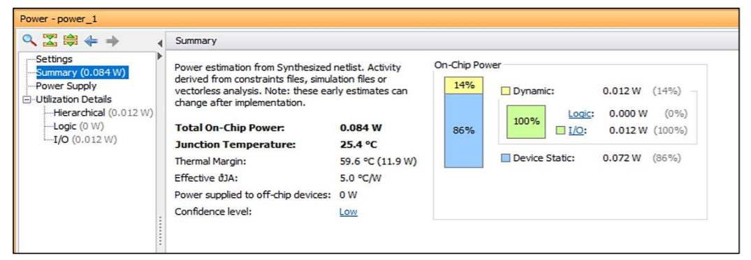
Results
The power comparison between Junfei Mao’s synchronous design versus asynchronous approach used in the project is shown in figure 22.
Final power is 0.084W
a)
b)
Figure 25: a)Synthesis report of Junfei Mao’s code.
b) Synthesis report of asynchronous design
33

Slide 34
Results
Power dissipation of the analogue delay block is calculated by using P = V * I where P is power, V is voltage and I is current through the circuit.
Power calculated from delay line is : 0.42W
Therefore, Total power dissipation is : 0.504W
The main objective of the project is achieved.
34

Slide 35
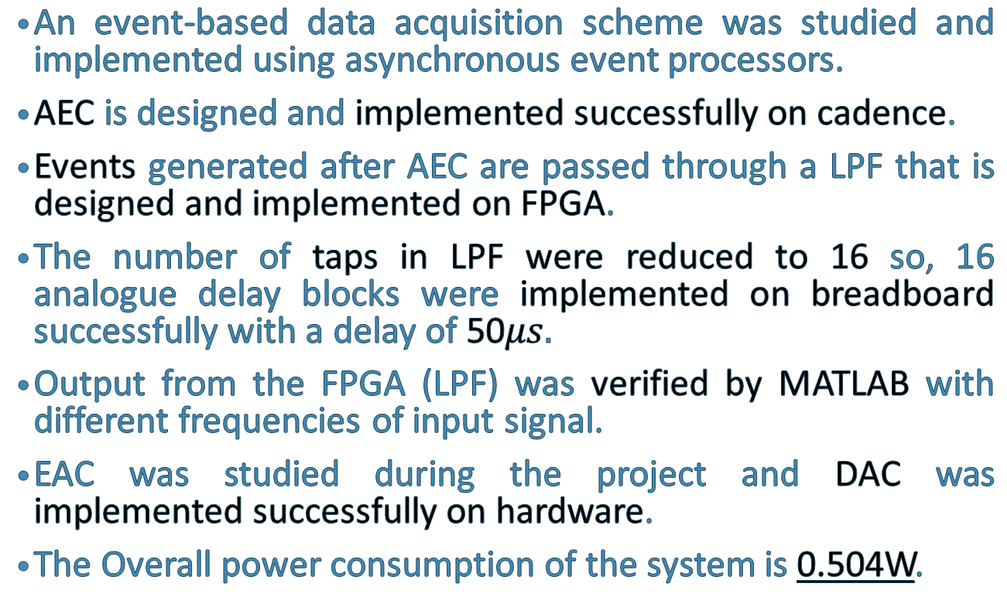
Conclusion
An event-based data acquisition scheme was studied and implemented using asynchronous event processors.
AEC is designed and implemented successfully on cadence.
Events generated after AEC are passed through a LPF that is designed and implemented on FPGA.
The number of taps in LPF were reduced to 16 so, 16 analogue delay blocks were implemented on breadboard successfully with a delay of 50$μs.$
Output from the FPGA (LPF) was verified by MATLAB with different frequencies of input signal.
EAC was studied during the project and DAC was implemented successfully on hardware.
The Overall power consumption of the system is 0.504W.
35

Slide 36
Application
Event-based signal processing offers the possibility of asynchronous and low power, data dependent processing.
There are large number of applications where this approach can be used such as wearable gadgets, health-care monitoring devices and implantable or digestible biomedical devices that need to function for long term and require low energy source.
36

Slide 37
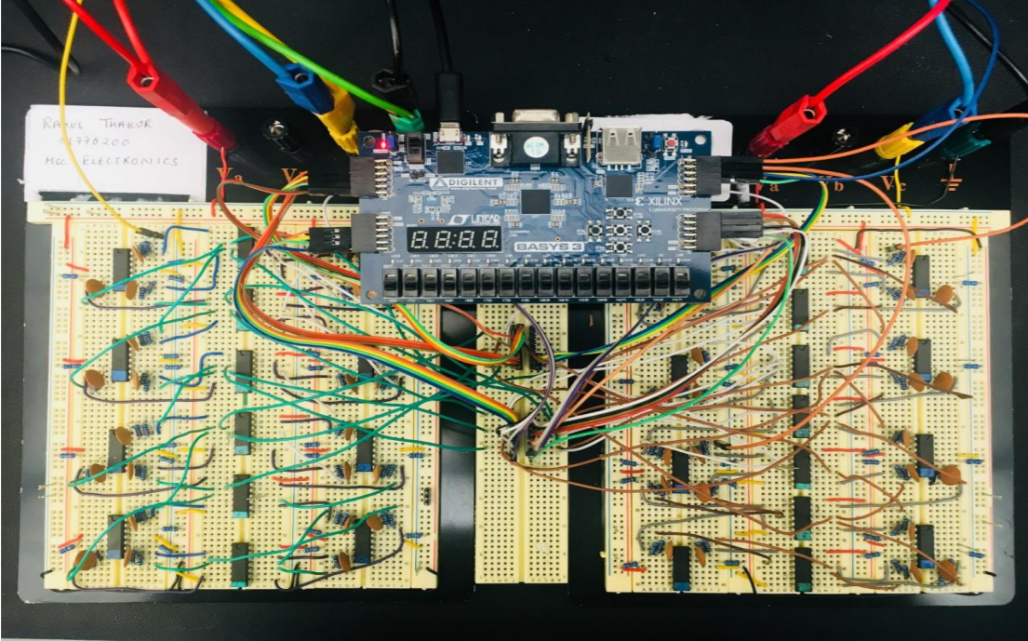
Hardware implementation of the system
Figure 26: The hardware implementation of the system.
37

Slide 38
References
[1] Y. Tsividis, “Event-Driven Data Acquisition and Continuous-Time Digital Signal Processing,” IEEE TRANSACTIONS ON CIRCUITS AND SYSTEMS—II: EXPRESS BRIEFS, vol. 57, pp. 577-581, 2010.
[2] J. Mao, “An Event-based Signal Processing Platform,” The University Of Edinburgh, Edinburgh, 2016.
[3] A. P. Rainy Chaplot, “Low Power Reconfigurable FIR Filter Based on Window Techniques for On Chip Network,” IEEE, pp. 291- 296, 2013.
[4] Wikipedia, “All pass filter,” Wikipedia, [Online]. Available: https://en.wikipedia.org/wiki/Allpass_filter. [Accessed 11 August 2018].
[5] H. Zumbahlen, “All Pass Filters,” Analog Devices, Norwood, MA, USA.
38

Slide 39
Thank You!
39

